Slide 1
Pollster Trust & Rankings
Understanding through Visualization
Ellen E. R. Gentile 12/ 07/2024
MSDS 570 - Visual and Unstructured Data Analysis

Slide 2
Overview
01.
06.
02.
07.
03.
08.
04.
09.
05.
10.
Introduction
Interactive Features
Dataset
Insights & Interpretation
Exploratory Data Analysis
Challenges
Methods & Tools
Future Work
Key Visualizations
References

Slide 3
01.
Introduction

Slide 4

Introduction
Problem: How can we trust what pollsters predict? Are there some pollsters that we can trust more than others?
Purpose: Election outcomes influence social and economic policy. Accurate prediction of these outcomes can minimize disruption and allow better planning for individuals & businesses.
Objectives: An interactive dashboard was created to:
Overview 538’s pollster rankings
Allow users to explore the data and methods behind those rankings
Promote understanding of how accurate and truthful different pollsters are

Slide 5
02.
Dataset

Slide 6
538’s Pollster Database, 2 Files
Pollster-ratings-combined.csv
Raw_polls.csv
Pollster rankings & aggregate measures that determined them.
540 rows x 13 columns
Individual poll and election result data within the database criterion defined by 538 (within 61 days prior to an election, only for certain types of elections, etc.)
20,466 rows x 30 columns

Slide 7
Pollster Ratings- Key Fields
Rank
Bias_ppm
Error_ppm
#Polls Total
FiveThirtyEight pollster rank based on numeric grade. Note that pollsters that are flagged as inactive do not have a numeric grade and appear at the end of the rankings; this is not intended to indicate anything about their skill level.
Predictive Plus-Minus for pollster bias, as described in the pollster ratings methodology.
Predictive Plus-Minus for pollster's absolute error, as described in the pollster ratings methodology.
Neptun ist der am weitesten entfernte Planet von der Sonne. Er ist auch das viertgrößte Objekt im Sonnensystem
Wtd. Avg. Transparency
POLLSCORE
% Partisan
#Polls Time Wt.
Score including both error and bias (but not transparency). Lower numbers are better. Stands for Predictive Optimization of Latent skill Level in Surveys, Considering Overall Record, Empirically.
Percent of the pollster's polls that are considered partisan by FiveThirtyEight's standards
Number of questions used to evaluate the pollster, weighted by the age of the survey.
Average transparency score for polls conducted by this pollster, weighted by the age of the survey

Slide 8
Raw Polls - Key Fields
Header | Definition
cycle | Election cycle.
location | Geography of the question. This may be a state, House district, or the US.
type_simple | Category of the race. This value is structured with the type of election (Sen, Gov, Pres, or House) followed by a dash, and then either P or G to indicate if the survey is of a primary or general election, respectively. House generic ballot polls are noted as House-G-US.
pollster | Pollster name.
aapor_roper | Boolean flag for whether the pollster is a member of the AAPOR Transparency Initiative or contributes polls to the Roper Center.
methodology | Mode used to conduct this poll. This should be a combination of one or more of the following values, separated by a forward slash: Live Phone — Live telephone interviews, may or may not include calls to cell phones IVR — Interactive voice response, otherwise known as automated polls or "robopolls" Online Panel — Opt-in online panel, either proprietary or contracted to a panel provider Text-to-Web — Recruitment via text messages that direct participants to a website to complete the survey Probability Panel — Probability based online panel Email — Recruitment via emails that direct participants to a website to complete the survey Mail-to-Web — Recruitment via snail mail that directs participants to a website to complete the survey Mail-to-Phone — Recruitment via snail mail that directs participants to call a phone number to complete the survey Text — Recruitment via text message in which questions are asked directly over SMS Mail— By U.S. mail or other “snail mail” service Online Ad — Recruitment via advertisement on websites, mobile games, or other online medium App Panel — Opt-in panel using a proprietary app Face-to-face — Poll conducted in person
polldate | Median field date of the poll.

Slide 9
Header | Definition
electiondate | Date of the election.
samplesize | Sample size of the question. For questions with no sample size available, this is approximated as the median sample size for races of the same type.
cand1_name | Name of Candidate #1. Candidates #1 and #2 are defined as the top two finishers in the election (regardless of whether or not they were the top two candidates in the poll). In races where a Democrat and a Republican were the top two finishers, Candidate #1 is the Democrat.
cand1_party | Party code for Candidate #1.
cand1_pct | Candidate #1's share of the vote in the poll.
cand1_actual | Actual share of vote for Candidate #1
cand2_name | Name of Candidate #2.
cand2_party | Party of Candidate #2.
cand2_pct | Candidate #2's share of the vote in the poll.
cand2_actual | Actual share of vote for Candidate #2
margin_poll | Projected margin of victory (defeat) for Candidate #1. This is calculated as cand1_pct - cand2_pct. In races between a Democrat and a Republican, positive values indicate a Democratic lead; negative values a Repubican lead.
margin_actual | Actual margin in the election. This is calculated as cand1_actual - cand2_actual. In races between a Democrat and a Republican, positive values indicate a Democratic win; negative values a Republican win.

Slide 10
Preprocessing
N/A Values
Drop Partisan
Check Outliers
N/A Values in the methods column of the poll data was imputed as “unknown”.
Kept N/A values for unranked pollsters in order to still assess their poll-based parameters
The Partisan column on polls dataset was inconsistent (source-based definitions) and some N/As so dropped
538 has remarkably clean data. The only column with possible outlier values was sample size, and this was critical and real data, so these values were maintained.

Slide 11
03.
Exploratory
Data Analysis

Slide 12
Statistical Summary- Polls
 | cycle | transparency score | time to election | sample size | cand1 pct | cand1 actual | cand2 pct | cand2 actual | margin poll | margin actual
count | 20466 | 20466 | 20466 | 20466 | 20466 | 20466 | 20466 | 20466 | 20466 | 20466
mean | 2011 | 5.59 | 23.78 | 912.59 | 44.82 | 48.31 | 42.63 | 46.37 | 2.19 | 1.94
std | 6.6 | 2.26 | 17.04 | 2117.13 | 8.53 | 8.11 | 8.98 | 9.01 | 13.84 | 14.71
min | 1998 | 0 | 1 | 86 | 3 | 10.45 | 0 | 0.78 | -78 | -76.88
25% | 2006 | 4 | 9 | 500 | 41 | 44.87 | 39 | 42.74 | -4 | -5.01
50% | 2012 | 5 | 19 | 632 | 46 | 48.83 | 44 | 47.39 | 2 | 2.18
75% | 2016 | 7 | 37 | 906 | 50 | 52.76 | 48 | 50.92 | 9 | 9.24
max | 2023 | 10 | 61 | 134,000 | 97 | 94.13 | 86 | 87.45 | 96 | 93.34

Slide 13
The Average Poll
2012
5
19
632
Election Cycle
Transparency score
Days before election
Sample Size
46%
48.83%
2
2.18
Cand 1
(Democrat)
Estimated Vote Share
Candidate 1
(Democrat)
Actual Vote Share
Estimated Democrat
Victory Margin
Actual Democrat Victory Margin

Slide 14
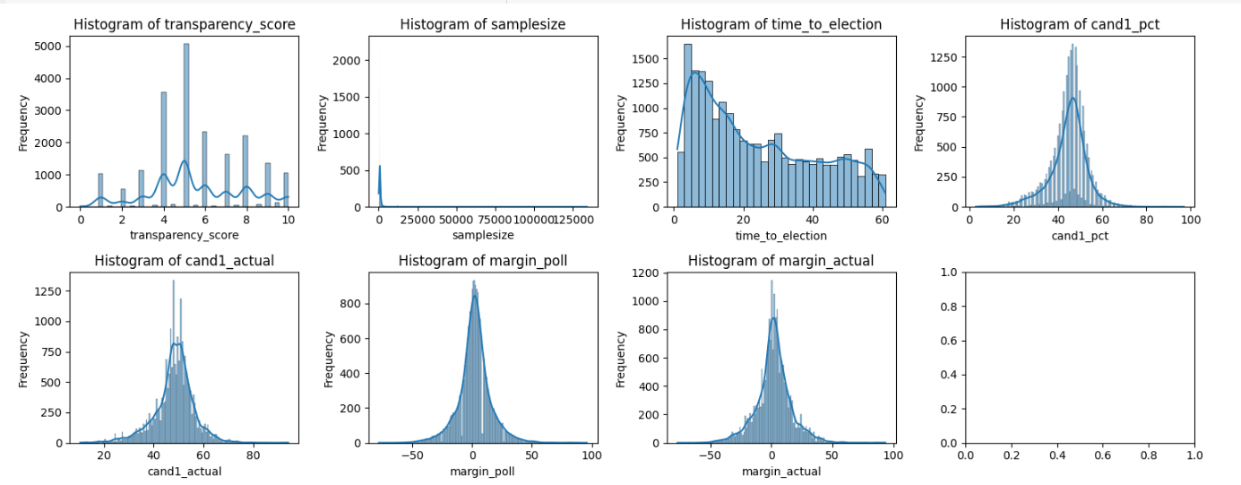
Distributions of Poll Numeric Fields

Slide 15
Statistical Summary- Ratings
 | rank | numeric grade | POLLSCORE | wtd. avg. transparency | # polls pollster total | % partisan work | error ppm | bias ppm | # polls pollster time wtd.
count | 282 | 282 | 540 | 540 | 540 | 540 | 450 | 540 | 540
mean | 141.5 | 1.74 | 0.02 | 4.05 | 24.76 | 0.18 | 0.07 | -0.02 | 10.39
std | 81.55 | 0.59 | 0.41 | 2.21 | 83.43 | .36 | 0.40 | 0.52 | 30.21
min | 1.00 | 0.5 | -1.50 | 0.00 | 1 | 0.00 | -1.20 | -2.00 | 0.00
25% | 71.25 | 1.3 | -0.13 | 2.88 | 2 | 0.00 | -0.10 | -0.20 | 0.48
50% | 141.50 | 1.7 | 0 | 3.50 | 5 | 0.00 | 0.00 | 0.00 | 1.90
75% | 211.75 | 2.1 | 0.20 | 4.60 | 16 | 0.00 | 0.20 | 0.30 | 6.33
max | 282.00 | 3.0 | 1.80 | 10.00 | 1101 | 1.00 | 1.90 | 2.00 | 272.60

Slide 16
The Average Pollster
141.5
1.7
0
3.5
Rank
Numeric Grade (Rating)
POLLSCORE
Wtd. Avg. Transparency
5
0%
0
1.9
Total # Poll in Database
Partisan Work
Error ppm & Bias ppm
# Polls Time Wtd.

Slide 17
Methods
& Tools
04.

Slide 18
Tools
Tableau
Python
Pandas
Msno
Tableau was used to create an interactive dashboard for users to explore the datasets.
Code used for preliminary data cleaning and exploration via statistical calculations, data grouping and aggregation calculations, and various plots.
Python library used to read in .csv files as dataframes and to preview and manipulate them.
A python library used to identify the extent and location of missing values in each field within a dataframe
Seaborn
Matplotlib
Plotly
Python graphing library used to examine data distributions through histograms and boxplots.
Base Python graphing library leveraged by Seaborn and Plotly, used to alter chart layouts and appearance.
A python graphing library used for several charts in the data exploration phase.

Slide 19

Techniques- Python
Boxplots & histograms:
poll data distributions
groupings such as sample size by election type
Grouped poll data by pollster
Investigated various aggregation methods such as:
nunique, min ,mean, median, max, std & var
Plotted time-series of error_ppm and bias_ppm by election year
for pollsters that did and did not contribute to AAPOR/ NCP transparency initiatives, using plotly.

Slide 20

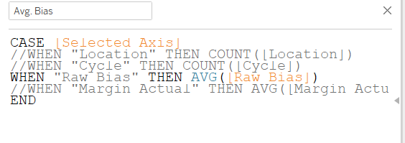
Techniques- Tableau
Tableau:
Joined Pollster Rating & Poll Data on pollster_id.
Created homepage with navigation links to all dashboards:
Created Parameters, Sets and Custom Calculations to be able to interactively select:
Visualized fields
Top N and Bottom N ranked pollsters
example custom calculation connected to interactive field choice:

Slide 21
05.
Key Visualizations

Slide 22
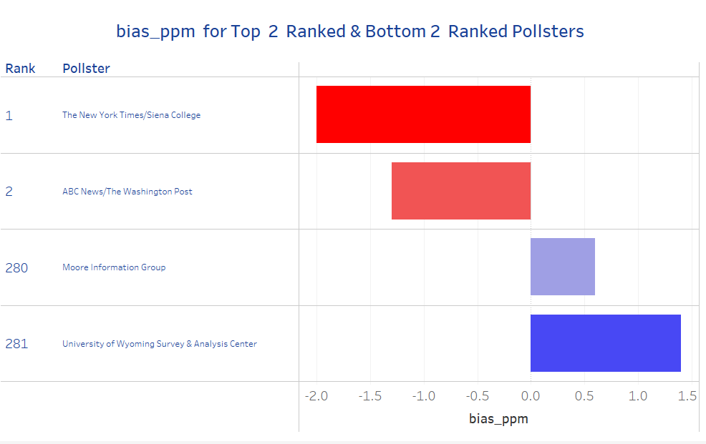
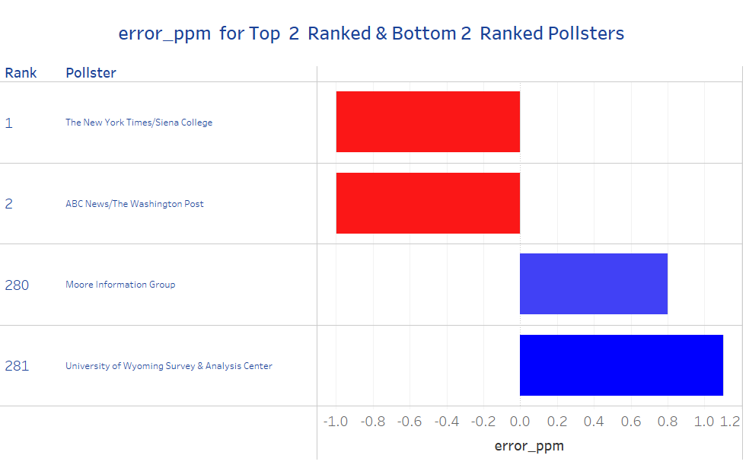
Bias PPM by Pollster
Error PPM by Pollster
Comparing Predictive Plus or Minus Bias across Top and Bottom Ranked Pollsters allows users to see that:
Top ranked pollsters have small negative bias values while Bottom ranked pollsters have small positive values.
Comparing Predictive Plus or Minus Error across Top and Bottom Ranked Pollsters allows users to see that:
Top ranked pollsters have small negative error values while Bottom ranked pollsters have small positive values.

Slide 23
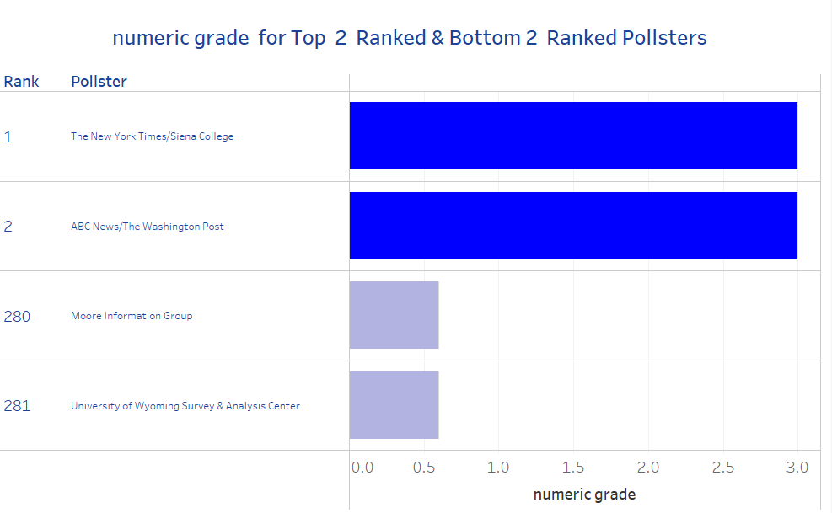
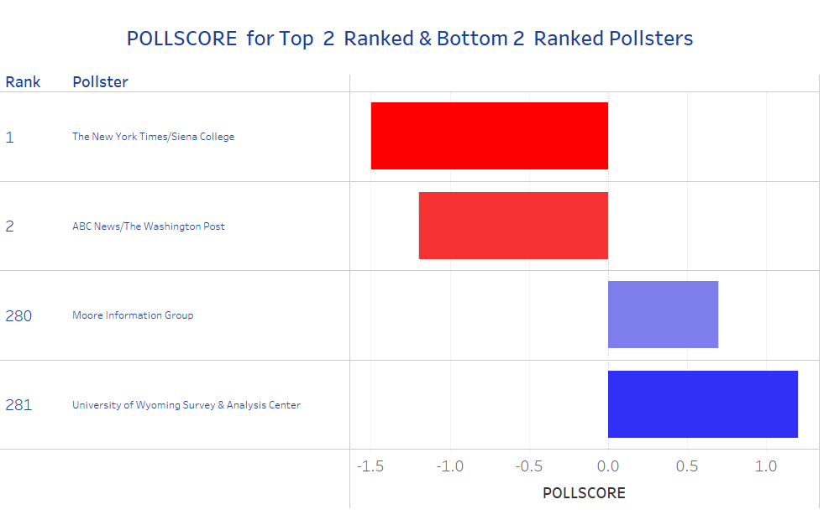
Numeric Grade by Pollster
POLLSCORE by Pollster
Comparing Numeric Grade across Top and Bottom Ranked Pollsters allows users to see that:
Top ranked pollsters have higher numeric grades than Bottom ranked pollsters.
Comparing POLLSCORE across Top and Bottom Ranked Pollsters allows users to see that:
Top ranked pollsters have lower POLLSCORES than Bottom ranked pollsters.

Slide 24
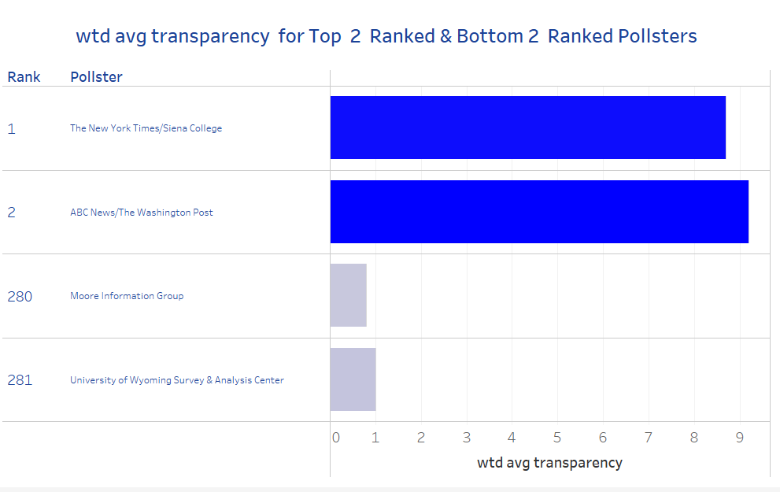
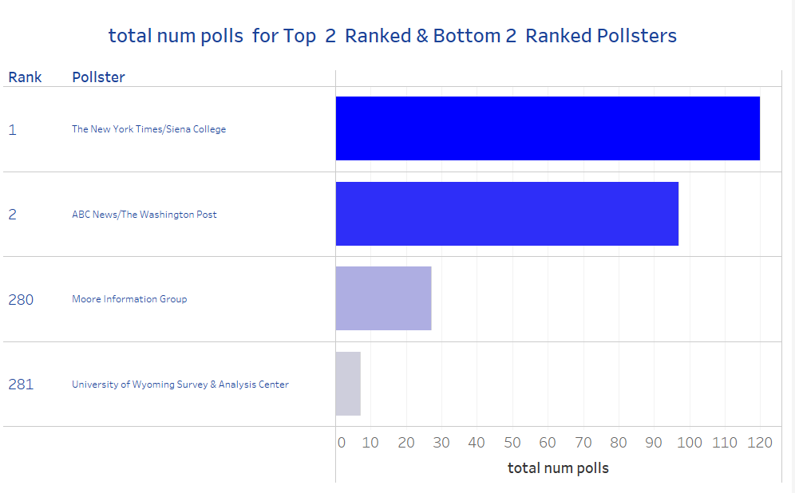
Weighted Avg. Transparency by Pollster
Total Number of Polls by Pollster
Comparing Weighted Average Transparency across Top and Bottom Ranked Pollsters allows users to see that:
Top ranked pollsters have much higher transparency than Bottom ranked pollsters
Comparing Total Number of Polls across Top and Bottom Ranked Pollsters allows users to see that:
Top ranked pollsters have many more polls than Bottom ranked pollsters

Slide 25
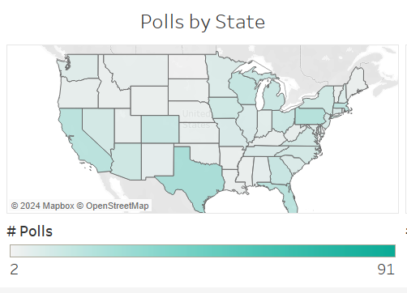
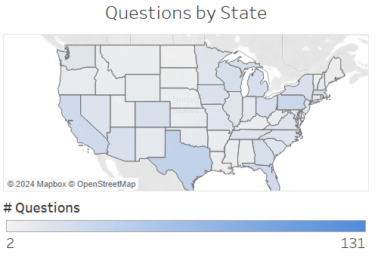
Chloropleth Maps
Show the number of polls and individual questions conducted in any given state. This map shows all polls and questions in the data conducted by the #4 pollster: You.Gov

Slide 26
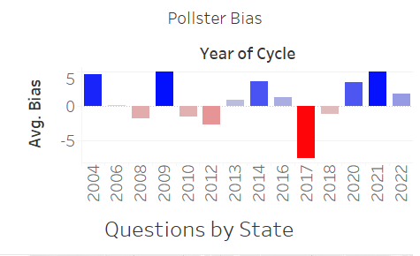
Time Series of a Pollster’s Avg. Bias
This lets us observe is a pollster consistently prefers one party over another (positive bias = Democrat, negative bias = Republican.

Slide 27
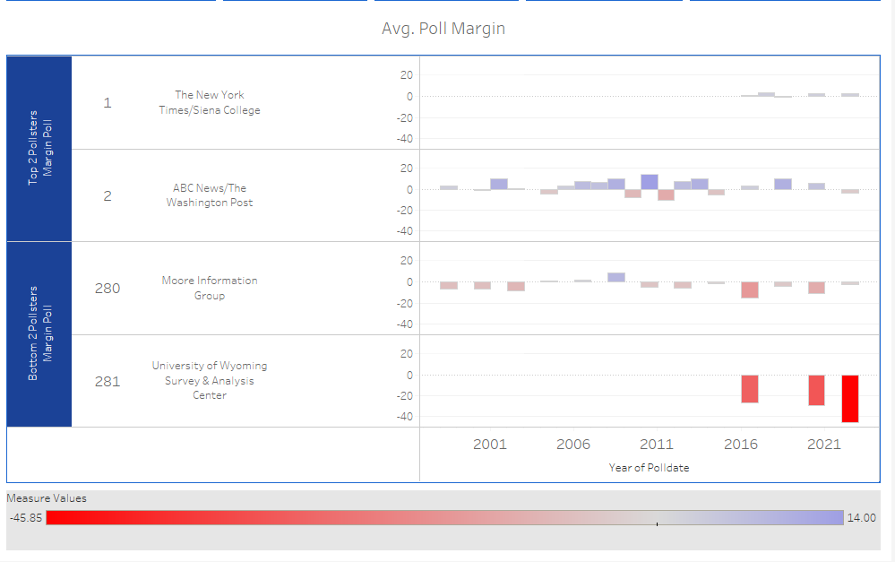
Average Poll Margin Comparison of Top & Bottom Ranked Pollsters
Shows the average predicted margin from polls within the defined scope from each top and bottom pollsters.

Slide 28
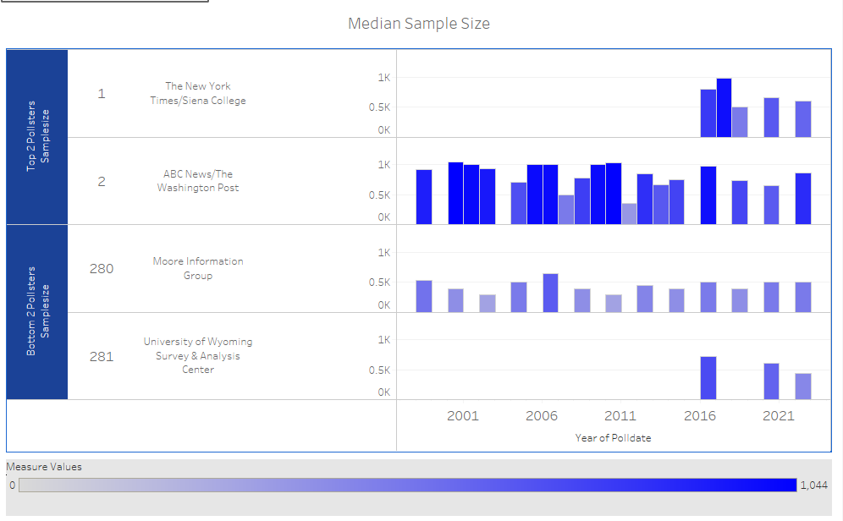
Median Sample Size Comparison of Top & Bottom Ranked Pollsters
Demonstrates that Top pollsters have typically have sample sizes between 500-1000, while Bottom ranked pollsters sample sizes are more variable.

Slide 29
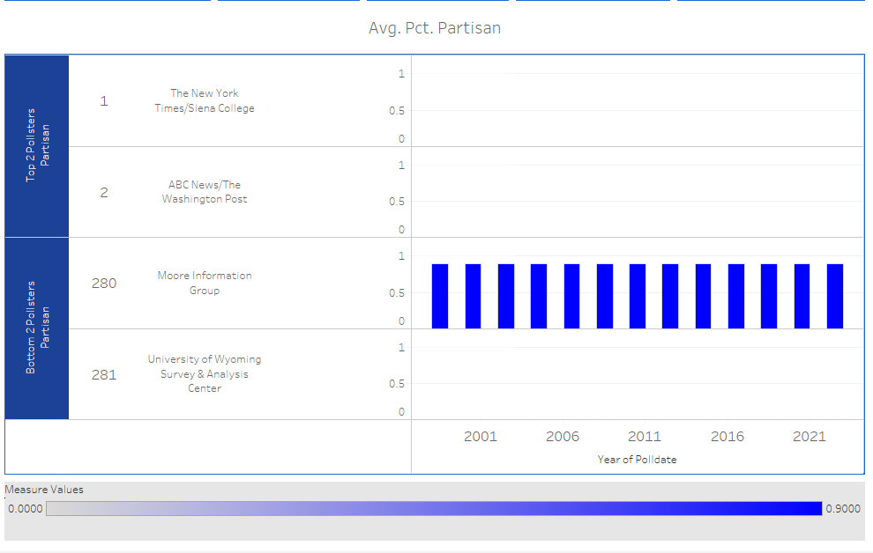
Avg. Pct. Partisan Comparison of Top & Bottom Ranked Pollsters
Demonstrates that Top ranked Pollsters do not participate in partisan polls, while Bottom ranked Pollsters do.

Slide 30
06.
Interactive Features

Slide 31
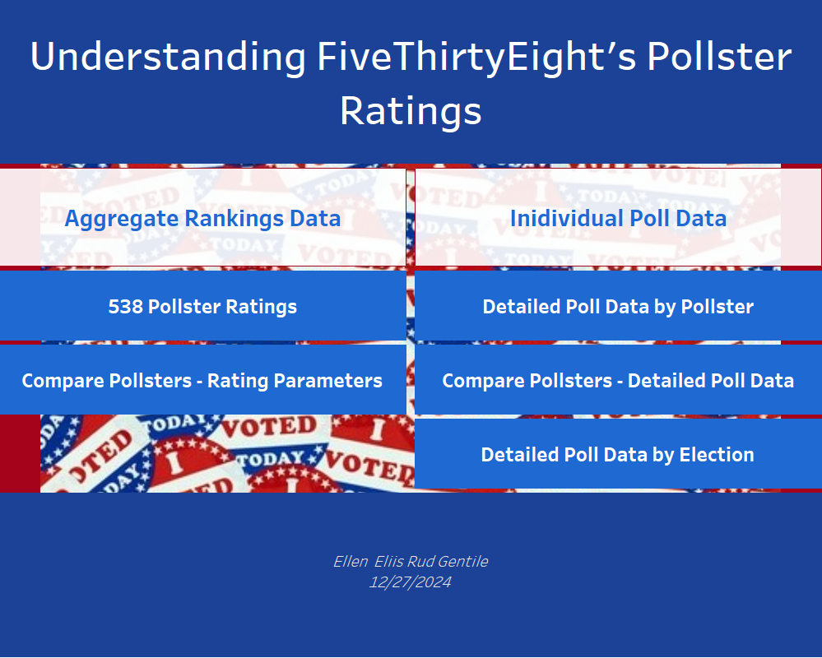
Home Page
Serves as primary landing page for the interactive Tableau dashboard.
Has links to each of 5 different interactive subsections.

Slide 32
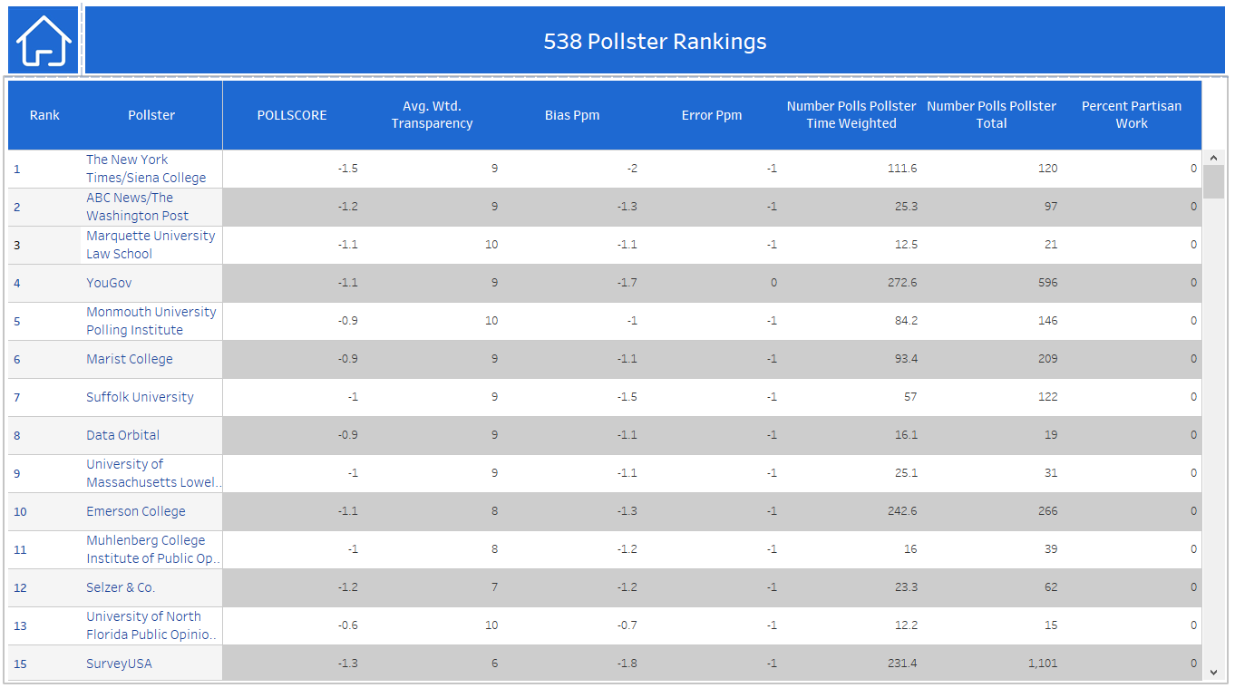
Overall Pollster Ratings
Ranking Parameters
Home Nav
Ranked Pollsters list serves as baseline for what the rest of the interactive visuals aim to explain

Slide 33
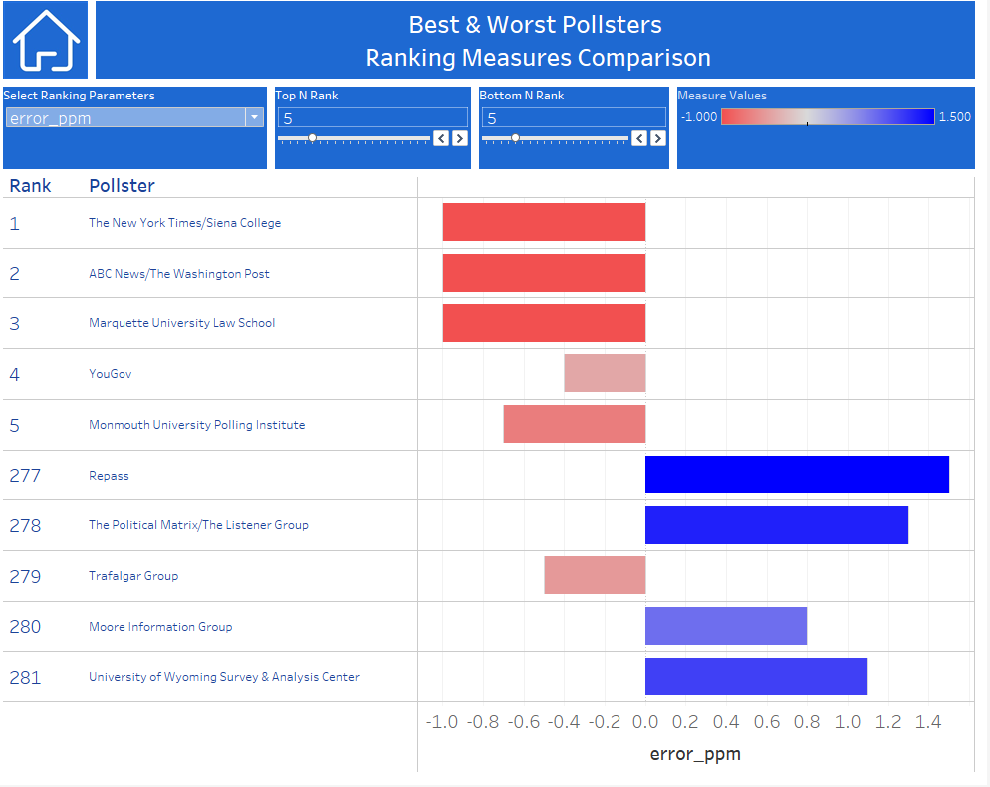
Compare Pollsters-Rating Parameters
Home Nav
Interactively Select Which Rating Parameter is Visualized
Choose N Top Ranked Pollsters to be Displayed
Choose N Bottom Ranked Pollsters to be Displayed
Users can understand how ranking parameters differ for top vs. bottom ranked pollsters. Grants perspective as to importance and directionality of ranking fields.

Slide 34
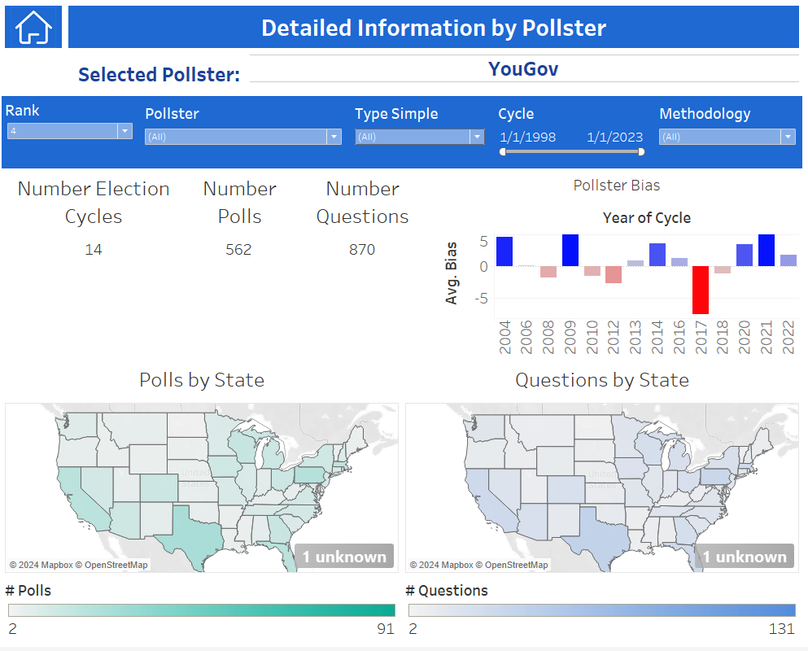
Detailed Data by Pollster
Select Pollster by:
Pollster Name
Rank
Filter Poll Data by:
Election Type
Election Cycle
Poll Method
Outputs include:
Total number of Election Cycles
Total Number of Polls
Total Number of Questions
Average Calculated Bias (average of Poll Margin - Actual Margin)
Number of Polls & Average Sample Size by State
Number of Questions by State

Slide 35
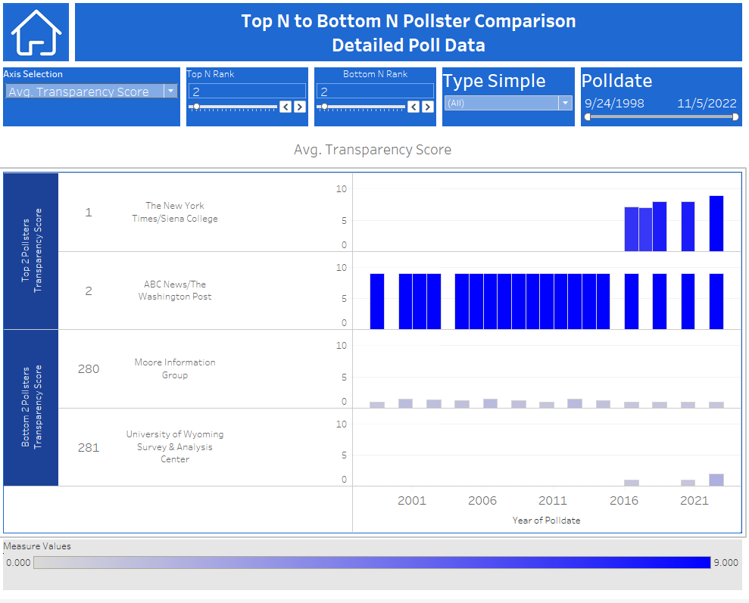
Compare Pollsters- Detailed Poll Data
Home Nav
Date Range Filter
Interactively Select Which Rating Parameter is Visualized
Election Type Filter
Choose Top N Ranked Pollsters to be Displayed
Choose Bottom N Ranked Pollsters to be Displayed

Slide 36
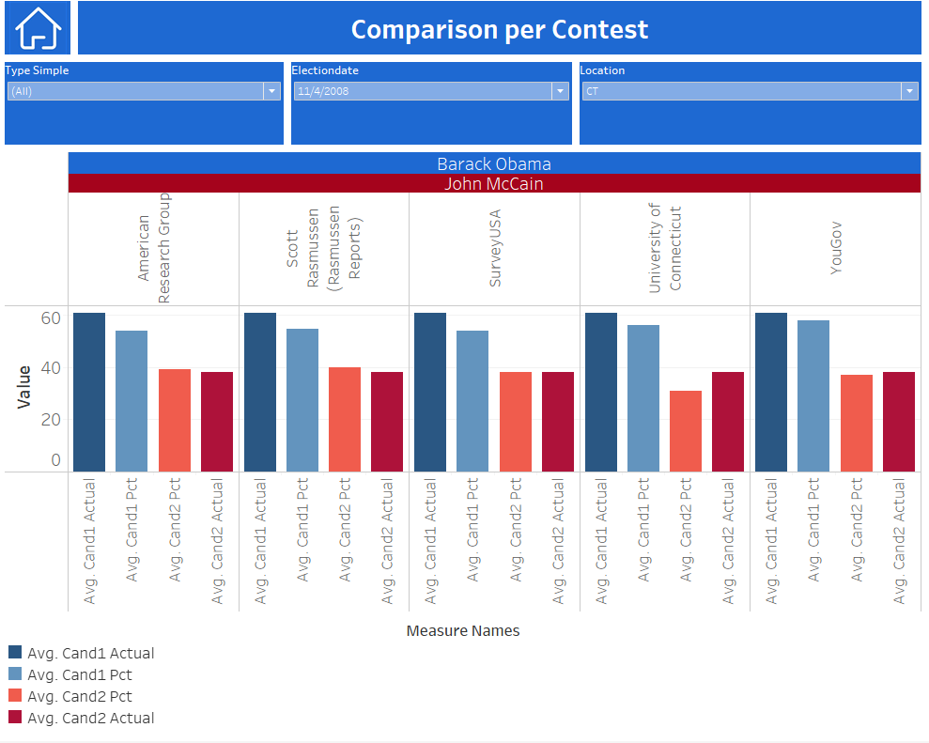
Detailed Data by Election
Select Election Type, Date & Location
View aggregate results for each pollster that participated in the selected combination, including:
Name of Candidate 1
Name of Candidate 2
Predicted & Actual vote share of each candidate

Slide 37
07.
Insights & Interpretations

Slide 38
Understanding Pollster Rankings
Top Ranked Pollsters
Bottom Ranked Pollsters
Transparent about methodology
Have low POLLSCORES
Have high numeric grades
Small negative values of error and bias
Samples sizes typically 500-1000
Many recent polls in database
Do not conduct partisan sponsored polls
Don't share methods
Have high POLLSCORES
Have low numeric grades
Positive bias and error
Irregular sample sizes
Few recent polls in database
Do conduct partisan sponsored polls

Slide 39
08.
Challenges

Slide 40
The biggest challenge with this project was the vast amount of complex data.
I had initially planned to use Dash to create the interactive dashboard.
Due to the complexity of the interactions I felt were necessary for a user to understand the data, I decided to pivot and use Tableau, which I have more experience with.

Slide 41
Future Work
09.

Slide 42
Future Work
To get from raw polls to rankings data 538 does not just aggregate their data, they also perform some weighting, zero-basing and other adjustments.
The scope of this work did not consider these adjustments.
For future work on this subject, I would like to learn more about how these adjustments are made, and how I might add them to the interactive visualization dashboard
I would also like to consider how this data may be used in predictive models.

Slide 43
References
Websites
How 538 calculates pollster ratings
538's ReadMe on Pollster Datasets
How to Create a TopN and Bottom N set in Tableau
Tableau parameter switching
Datasets
https://github.com/fivethirtyeight/data/blob/master/pollster-ratings/pollster-ratings-combined.csv
https://github.com/fivethirtyeight/data/blob/master/pollster-ratings/raw_polls.csv
Published Tableau Dashboard:
https://public.tableau.com/views/Understanding538PollsterRankingData/DetailbyRace?:language=en-US&publish=yes&:sid=&:redirect=auth&:display_count=n&:origin=viz_share_link

Slide 44
Thank You!
Questions?
egentile24@mmc.edu
ellen.gentile@ascension.org
+1 585 703 0968

